Slide 1
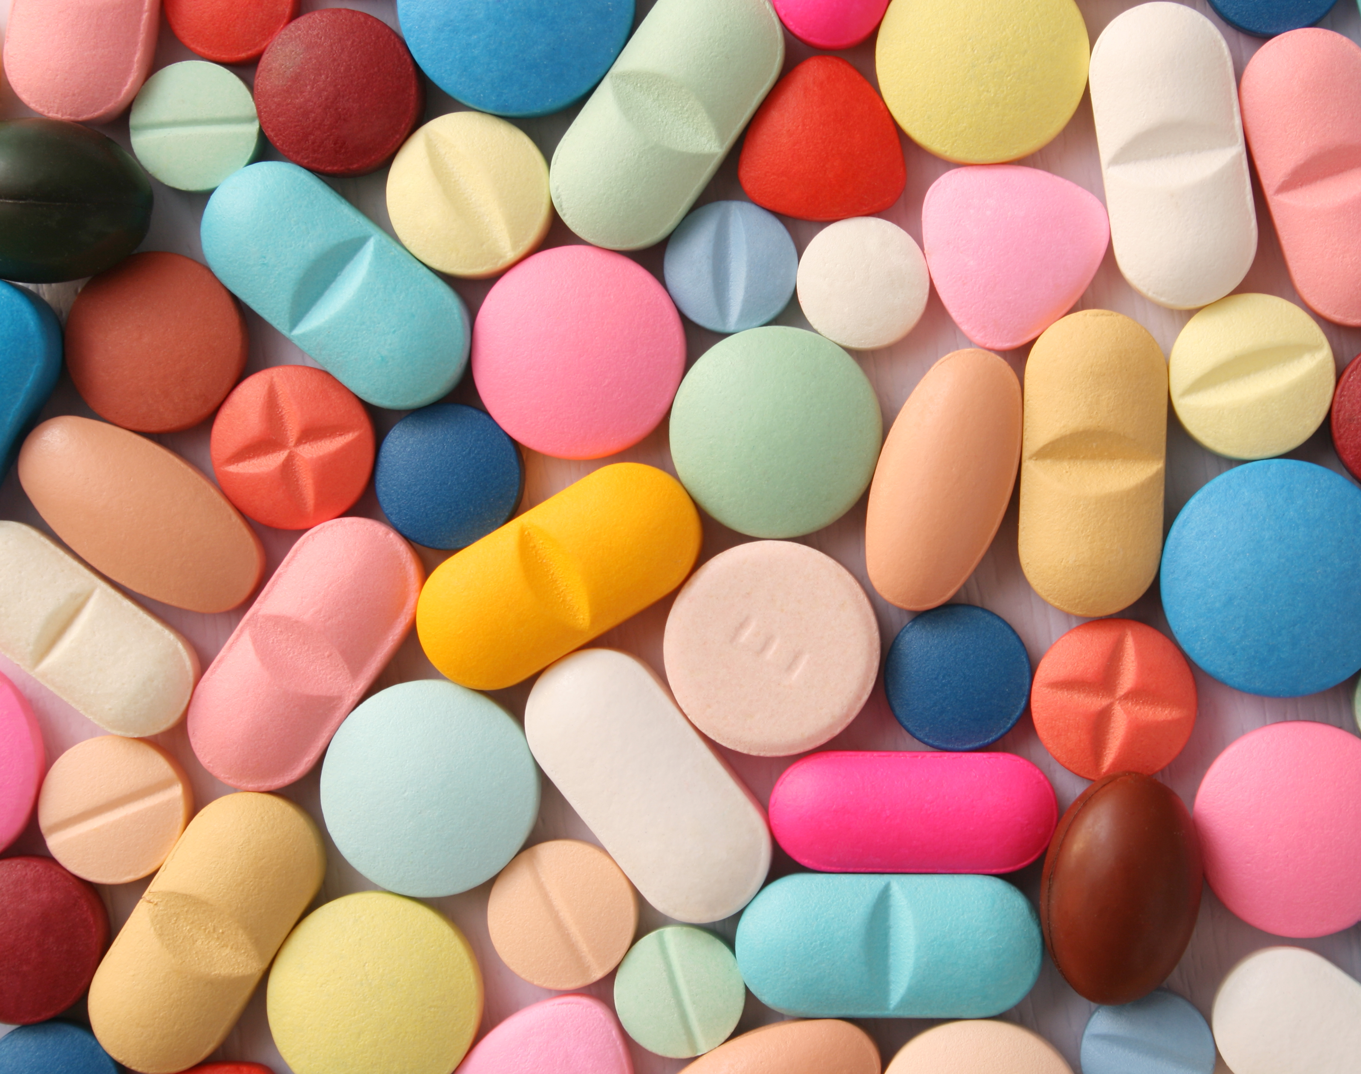
Opioid Settlements for Missouri
0ctober 24, 2024

Slide 2
Background
In 2021, major settlements were reached to resolve opioid litigation against McKesson, Cardinal Health, AmerisourceBergen, and Janssen Pharmaceuticals (J&J), with these companies agreeing to pay up to $21 billion and $5 billion, respectively, over several years. In 2022, further settlements were made with CVS, Walgreens, Walmart, Teva, and Allergan, totaling billions more in payments, with requirements that at least 85% of the funds go towards opioid abatement efforts.
These settlements also impose business practice changes to prevent future opioid misuse, such as monitoring suspicious orders and ceasing opioid marketing and lobbying. Ongoing negotiations with additional defendants like Kroger and Hikma continue, while claims by Tribes and private parties remain unresolved.
From: nationalopioidsettlement.com/

Slide 3
Context
I will be examining the Opioid settlement payouts for the state of Missouri.
How do the payouts vary over time?
How do the payouts vary by county?

Slide 4
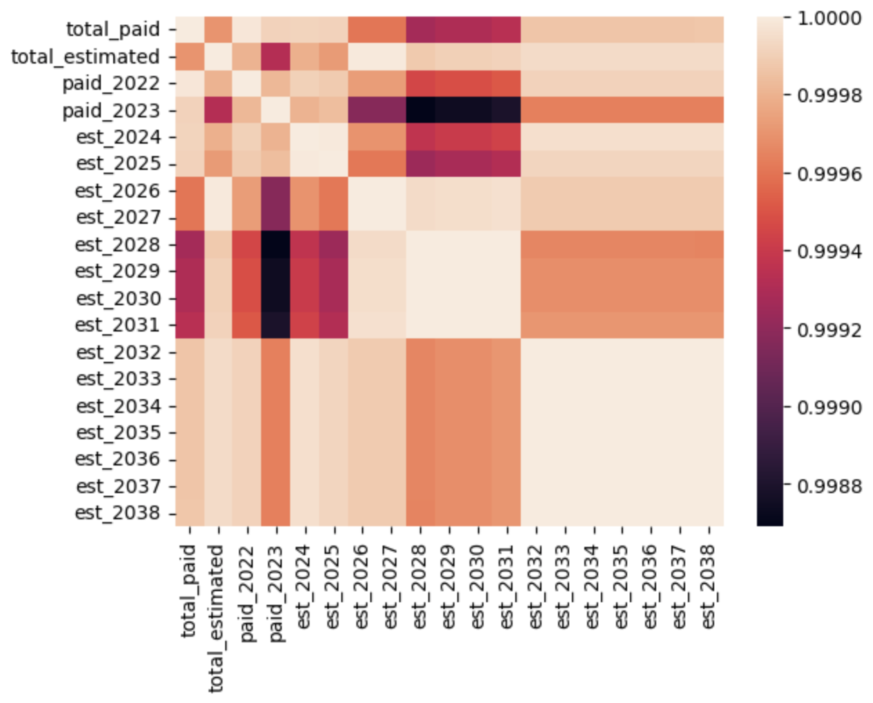
Correlation
The entire dataset is highly correlated.
The lowest correlated variables have a correlation of 0.9988.
Correlation does not reveal much about this dataset.

Slide 5
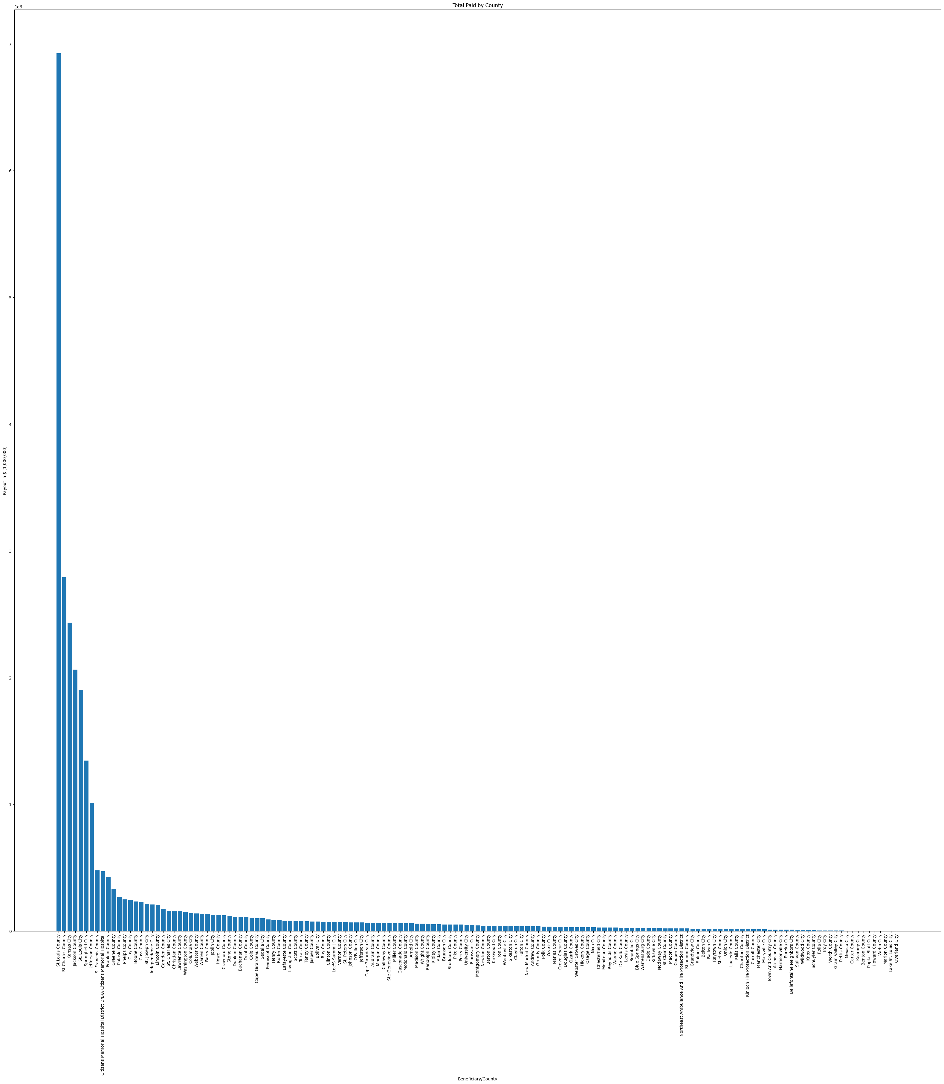
Settlement Payment Totals
Based on the extreme variation in payment amounts, I decided to examine the top 25 counties.

Slide 6
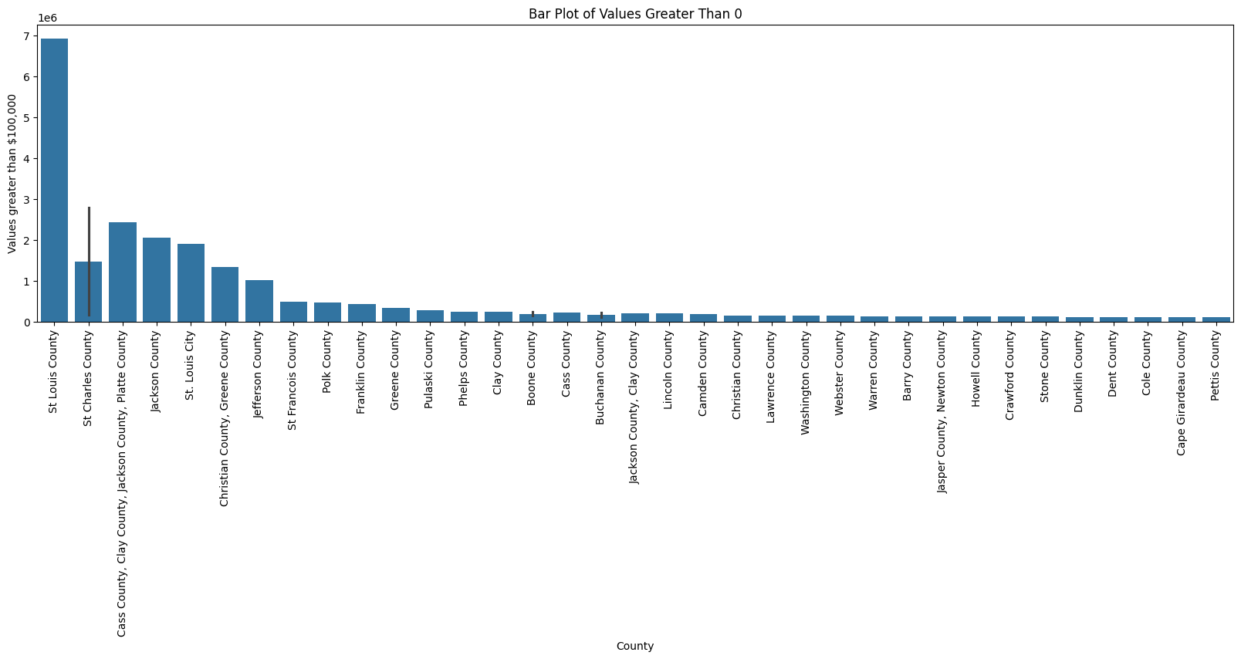
Settlement Payment Totals
Payments in $1,000,000s
Counties receiving greater than $1million:
St. Louis County
St. Charles County
Cass County/Jackson County/Platte County
Jackson County
St. Louis City
Christian County/Greene County

Slide 7
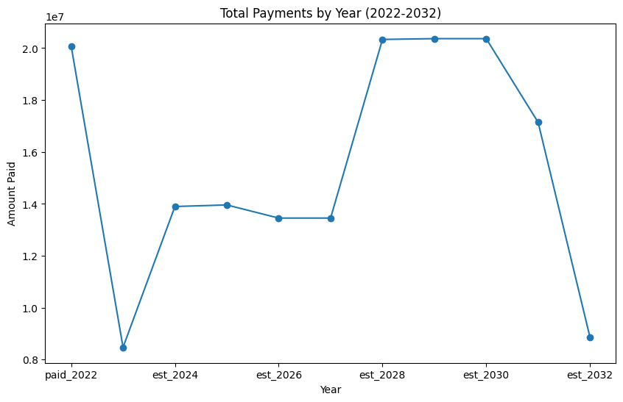
Total Payments by Year
Out of the payments made, 2022 was the year with the highest payment so far.
Out of the estimated payments for future years, 2028-2030 are expected to be the same as 2022.
2023 dropped significantly from 2022, and 2032 is expected to be a significant drop from 2031.

Slide 8
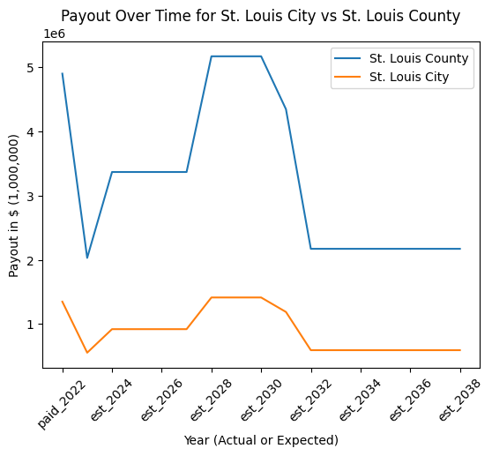
Payout Over Time for St. Louis City and County
St. Louis is one of two American cities that is divided into a city and county.
St. Louis City’s population is significantly smaller than St. Louis County.
The trajectories for both payout schedules are the same, but the county will always receive more payouts than the city.

Slide 9
Next Steps
Examine the relationship between population and settlement payouts.
Examine the relationship between overdoses and settlement payouts.
Analyze the impact of settlement payouts on future overdose numbers.

